Slide 1

Chapter 4

Slide 2

Using variables
Bound and free variables
Anonymous variables
Compound variables
Compound Goals
Backtracking
Variable rules

Slide 3


Used in a clause or goal to specify an unknown quantity
Variable Naming rule:
  Must begin with a capital letter
  Rest of the character may be
    upper/lower case letter,
    number
    Underscore (_)
  At best 250 character long
Some Valid variable name
Age
Disease
Patient
John_smith
Speaker4

Slide 4

domains
diseases , indication=symbol
predicates
symptom(diseases , indication)
clauses
symptom( chicken_pox , high_fever).
symptom( chicken_pox, chills).
symptom( flu, chills).
symptom( cold, mild_boby_ache).
symptom( flu, severe_body_ache).
symptom( cold, runny_nose).
symptom( flu, runny_nose).
symptom( flu, moderate_cough).
Goal :symptom( Disease , runny_nose)
Disease =cold
Disease =flu
2 Solution

Slide 5
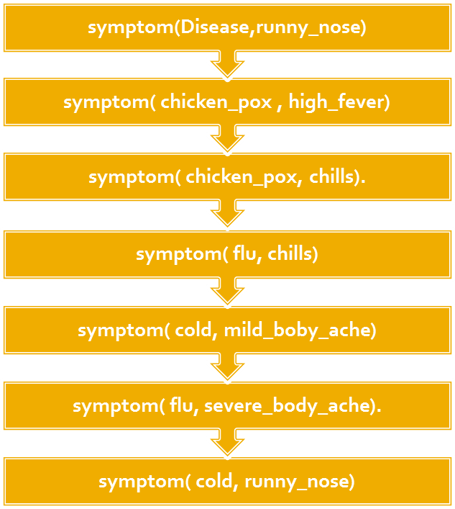

Goal :symptom( Disease , runny_nose)
Disease =cold
Disease =flu
2 Solution
Goal succeed
Goal Succeed
(Display binding)
Goal Succeed
(Display binding)

Slide 6

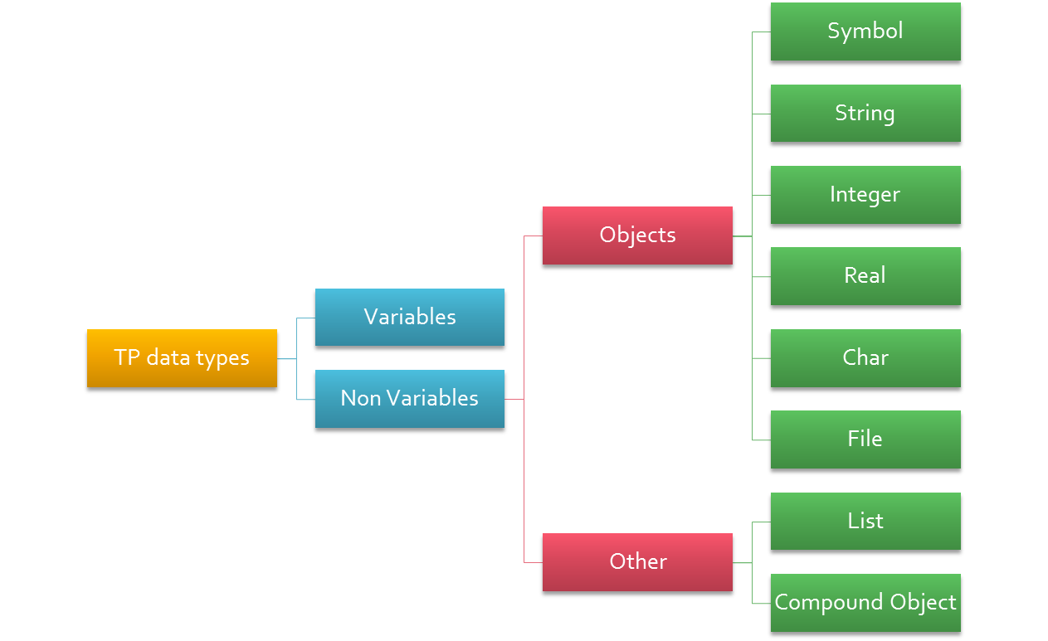

Slide 7

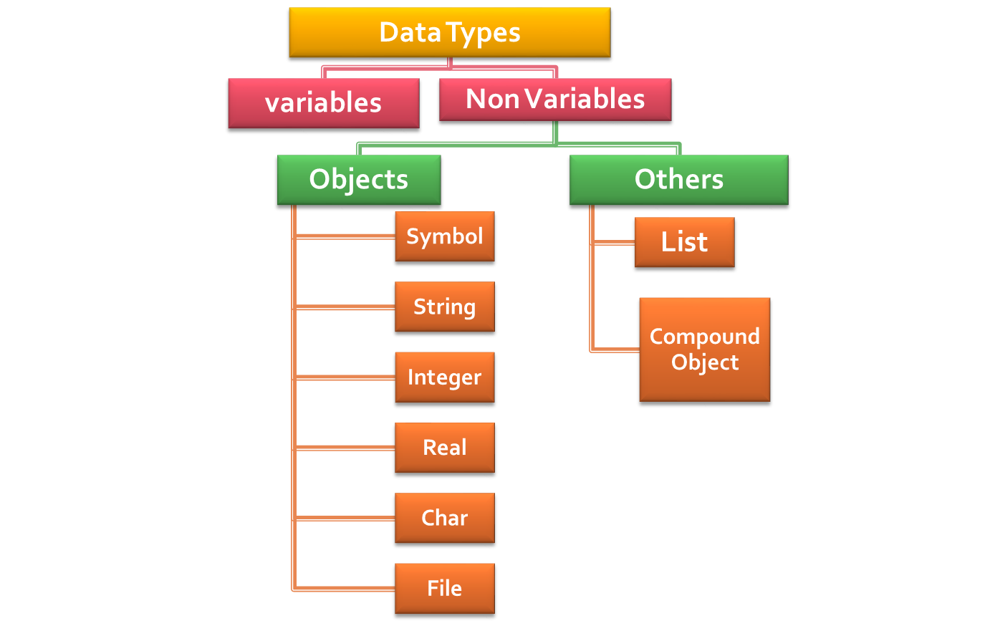

Slide 8

Bound Variables: Variable that has value at a particular time is called bound or instantiated.
Free Variable: Variable that does not have value at a particular time is called free or uninstantiated variable
C language equivalent
int x; ← x is currently free
x = 5; ← x is bound to value 5

Slide 9

Used to ignore value of one or more argument of a clause/rule.
Expressed using underscore ( _ )
Example:(used in gole)
  Goal: symptom( _ , chills)
  True
Example 2:( used in clause/rule)
  likes( jane, _ )
Is “chills” an indication for any disease
Jane likes everything

Slide 10


domains
diseases , indication=symbol
predicates
symptom(diseases , indication)
clauses
symptom( chicken_pox , high_fever).
symptom( chicken_pox, chills).
symptom( flu, chills).
symptom( cold, mild_boby_ache).
symptom( flu, severe_body_ache).
symptom( cold, runny_nose).
symptom( flu, runny_nose).
symptom( flu, moderate_cough).
Goal :symptom( Disease , runny_nose) and
symptom( Disease , mild_body_ache)
Disease =cold
1 Solution
All of the specified condition must
Succeed for the goal to succeed

Slide 11

The most important principles of prolog execution is backtracking. The solution of compound goal proceeds from left to right. If any condition in the chain fails, prolog backtracks to the previous condition, tries to prove it again with another variable binding, and then moves forward again to see if the failed condition will succeed with the new binding. Prolog moves relentlessly forward and backward through the conditions, trying every available binding in an attempt to get the goal to succeed in as many ways as possible.

Slide 12
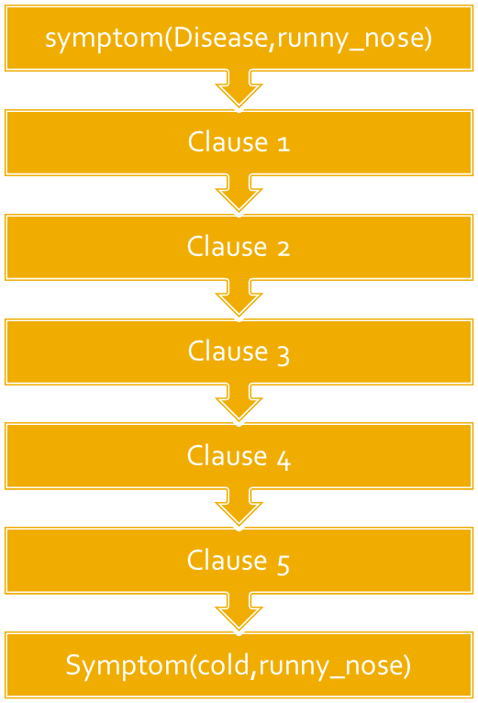
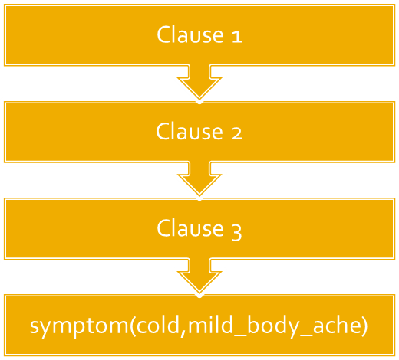
Goal Succeed
(Display Bindings)

Slide 13

Must begin with a capital letter. Rest of the character may be upper/lower case letter, number, Underscore (_). At best 250 character long
A variable is either free or bound at any given time
Variable binding applies to specific clauses.
Once a variable is bound to an object, it is typed the same as the object

